Slide 1
How to run NU-WRF Chem
Following NASA’s tutorial,
Branching from the tutorial,
Tips,
Common errors

Slide 2
Preface
This tutorial assumes you follow NASA’s nu-wrf tutorial as the rough guidelines for using a NU-WRF sim on discover and really becomes an index for speedbumps while following their tutorial. For others who may walk this path, there will undoubtedly be many problems I can’t cover here and you’ll have to solve. Depending on your simulation, you’ll need to install a couple other scripts/libraries related to Anthro_emiss and bio_emiss. These require specific libraries/versions (seen below) that sometimes don’t play nice on Discover or even SuperMIC.
My solution was to use Ubuntu to make a fresh linux to install these.
These sorts of things have their own problems and troubleshooting required that I may at some point in the future include, but it is unlikely.
Later I link the youtuber Amir Hosseinnikfal. He was my spirit guide for much of the Anthro/bio emissions, check out his tutorials for further detailed help.
The general tutorial I followed was this one
https://nuwrf.gsfc.nasa.gov/sites/default/files/docs/nuwrf_v11_tutorial.pdf
If it no longer exists or the link doesn’t work, you should be able to google “NASA NU-WRF tutorials” and find it, they may have updated things so be wary of outdated info presented here
I have you copy the chemistry_workflow dir but this guide assumes you have a copy of the chem directory from:
/discover/nobackup/projects/nu-wrf/tutorial/chemistry_workflow
Or you got the same dir off github
This directory is designed to pair with their tutorial and is a good starting point as all their scripts are automated and interplay with the rest of the Discover server’s libraries and paths
This guide assumes you are following the tutorial but will state at which points I ran into trouble with it and how to fix them
I would recommend completing the tutorials for the Basic and Chemistry workflows before starting your own sims, but this guide will help use their tutorial data too.

Slide 3
Getting Started
Make a dir for where you plan to work in. (this was my 4th dir hence the “_4”)
mkdir /discover/nobackup/cpjohns7/scratch/chemistry_workflow_4
cd chemistry_workflow_4
cp -r /discover/nobackup/projects/nu-wrf/tutorial/chemistry_workflow/* .
Set these in your common.reg file
export RUNDIR=/discover/nobackup/cpjohns7/scratch/chemistry_workflow_4
export PROJECTDIR=/discover/nobackup/projects/nu-wrf
export NUWRFDIR=/discover/nobackup/cpjohns7/nu-wrf-dev-chem/
Gotta change the account on all the scripts to
S2437 (although if you’re using this in the future you likely have a different account)
If you submit a job, Highly recommend using qstat -u [your username] to find your submitted jobs as the Discover servers are flooded so with job submissions
Also, I recommend setting an alias for that command because you’ll be using it a lot. I use “qs”
Follow the tutorial here and check back when you encounter a problem!

Slide 4
gocart2wrf
This is likely the first real hiccup you’ll encounter.
In the tutorial it’s no problem. For your own future sims you’ll want to download data from
https://goldsmr5.gesdisc.eosdis.nasa.gov/data/MERRA2/
Use the nu-wrf user guide page 43 and the next slide
https://nuwrf.gsfc.nasa.gov/sites/default/files/docs/nuwrf_userguide_v11.3.pdf
To help make necessary alterations to your namelist.gocart2wrf

Slide 5
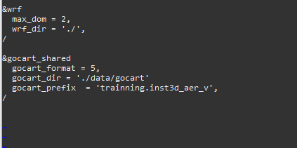
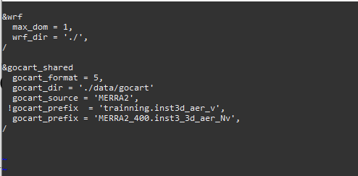
gocart2wrf
Default tutorial
Example using data from previous slide.
Important: the dataset expects the following directory if you’re using the data downloaded from the previous slide’s link. Though depending on the year your MERRA2 data I believe the “_400” might be different
/discover/nobackup/cpjohns7/scratch/chemistry_workflow/data/gocart/MERRA2_400/stage/Y2013/M05
So be sure to make the /MERRA2_400… dirs within the data/gocart dir then place your gocart2wrf data within that M05 dir

Slide 6
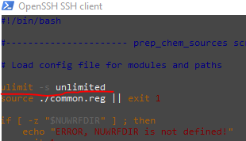
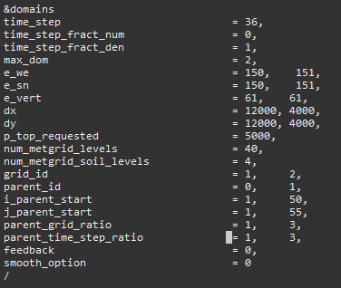
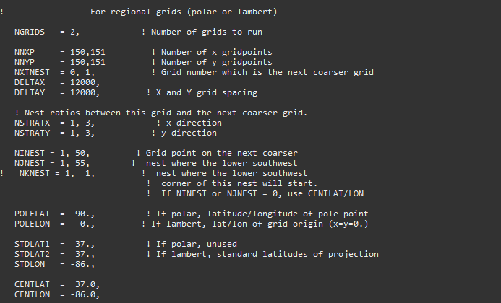
prepchemsources
Likely the next issue.
Make sure your prep_chem_sources.inp file has the correct date
Make sure your namelist.input settings for your domain size are correct in your prep_chem_sources.inp file
Add “ulimit -s unlimited” to your prep_chem_sources.reg
prep_chem_sources.inp equivalents
Namelist values

Slide 7
Convert_emissions
Add “ulimit -s unlimited” to your convert_emiss.reg if you’re encountering some sort of memory or generally unexplainable issue you’re having upon job submission.
Copy the following from your nu-wrf-dev-chem dir if it says you’re missing it. The tutorial dir is missing this file and it’s essential.
cp [path to]/nu-wrf-dev-chem/WRF/run/CAMtr_volume_mixing_ratio .
If you need to run this multiple times check your ce.slurm.out to see what’s up. If it says something like wrfinput_d01 is identical. Delete the wrfinput_d01 file. Then run it again serially. It won’t work that time, that’s expected but it saves you from having to wait an hour for a job to run. Submit it via sbatch a 3rd time and it should work.
Other issues likely are coming from your namelist.input.convert_emiss.d01 or d02

Slide 8
WRF
Add “ulimit -s unlimited” to your wrf.reg script
Often you’ll have to mess around with the amount of nodes/processors you can use for your situation
Each node on discover has 46 processors. You can request nodes, you can request processors.
I’ve found the combination that works for me is to add
#SBATCH --ntasks=100
#SBATCH --ntasks-per-node=46
#SBATCH --mem-per-cpu=4G
Add an additionally “#” to the line that says “#SBATCH --qos=debug”
This line normally forces a particular que for your job to run in, but if you don’t use that line then it’ll use whatever processors are available resulting in your job reaching the top of the que faster

Slide 9
Anthropogenic Emissions
This has been a tremendous difficulty with nu-wrf. I started trying to use NEI-RETRO Anthro emissions as that seems fairly commonly used, but I could not get around an error stating that the wrfem… file required too much data.
Luckily, There are several work arounds for possible situations
Towards the very end of my first logbook, I have much information detailed on setting up these processes and the errors I encountered and solved doing so. I may add those here with time, but for now I will just run through the general possibilities you could use to incorporate Anthro_emiss

Slide 10
Prep_chem_sources
So this one is technically the easiest to use, but not really because NASA’s emissions inventories blow chunks
If you use the tutorial prep_chem_sources you’ll probably run into an error that the EDGAR data (if using) doesn’t exist.
I had to download the emissions inventory myself and make sure to use the EDGAR-HTAP option (it’s also the most current set so should probably use anyhow).
You’ll also probably have to tinker with the namelist.input.
Specifically, the chem_opt, emiss_opt settings.
Presently 112,5 respectively. This I believe works with convert_emiss to generate the necessary wrfchemi_d0 files.

Slide 11
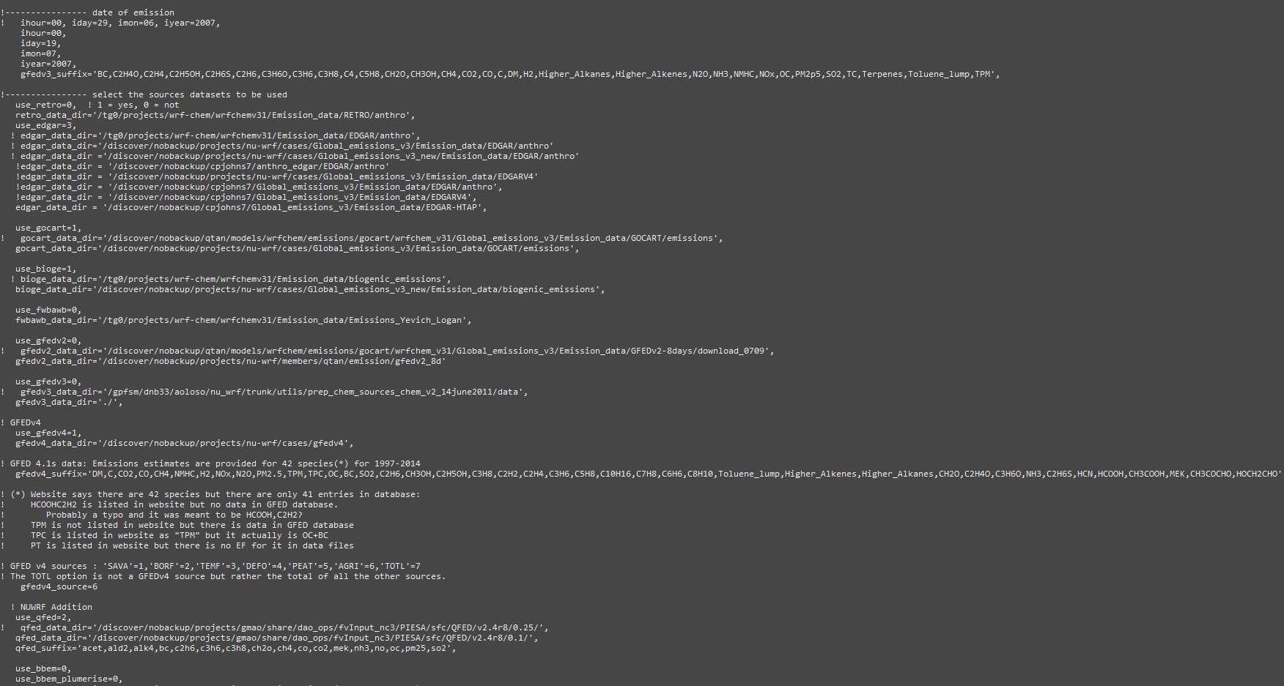
Prep_chem_sources
Expand the image as you need. The paths and settings in the prep_chem_sources.inp I have set on there seem to work for me. As stated on the last slide though, I had to download my own EDGAR data, but that’s pretty easy to do.
The “use_edgar =3” line indicates which version of EDGAR data you’re using.
I don’t recall the specifics of setting 0,1,2 but they use different versions of EDGAR and that info is outthere somewhere.
You can take the output from prep_chem and jump right into conver_emiss, or you can incorporate other outside Anthro_data. The outside Anthro data does contain some extra/other aerosols so depending on your sim, it may be worth it, but just using Prep-chem is the easiest

Slide 12
Anthro_emiss
There is another method to use however
It should be noted that these do produce slightly different aerosol variables than through the prep_chem_sources method so make sure you know what you want because using Anthro emiss overwrites the prep_chem_sources->convert_emiss wrfchemi files.
You still want to do the prep_chem_sources->convert_emiss though because that method generates wrfchemi_gocart_backg files which are not generated through Anthro_emiss
You can follow some tutorials by
https://www.youtube.com/@amirhosseinnikfal968
To get the Anthro_emiss directories up and running

Slide 13
Anthro_emiss
On my Ubuntu I have everything set up in the /home/philip/ANTHRO/src dir
If you run into a library not found error even though its there, be sure to set the variables as stated in the below link. I set mine in the ~/.bashrc file so I shouldn’t have to worry about it, otherwise you’ll have to set it every time you launch your Linux.
https://forum.mmm.ucar.edu/threads/libnetcdff-so-5-cannot-open-shared-object-file.12610/
I also followed a lot of the tutorials of the youtuber Amirhossein Nikfal
https://www.youtube.com/@amirhosseinnikfal968
All of these relating to wrf/chem were hugely helpful

Slide 14
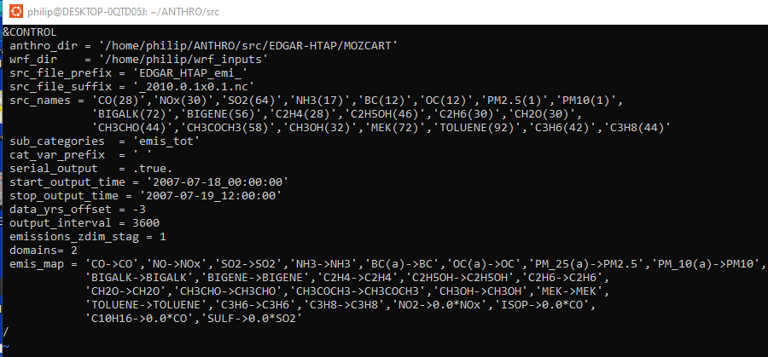
Anthro_emiss
In Ubuntu, I recommend making a directory to keep wrfinput files that will get called by Anthro_emiss and bio_emiss.
move your wrfinput files to the [path to]/wrf_inputs you’ve made
navigate to the [path to]/ANTHRO/src dir
Clear any existing wrfchemi files
Edit your .inp file. I use the pictured general params
Set where it finds your Anthro dir, wrfinputs, and src files.
Note, I’m using 2010 data for this 2007 simulation, hence the data_yrs_offset.
As I usually use hourly emission data (for these short sims I’m doing) I make sure it’s outputting every hour (3600 seconds) and serial output (new file per hour) as I run into issues with wrf-chem and not setting the files to be serial.
Otherwise I basically don’t touch the subcats, emis_map,src_names, etc.
Run the Anthro emiss as:
./anthro_emis < MOZCART.inp

Slide 15

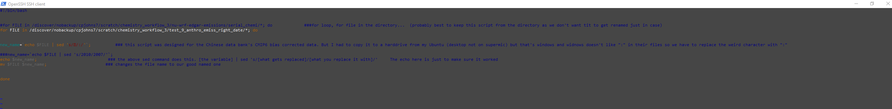


Anthro_emiss
If you have to make the wrfchemi files then upload them via WinSCP to the supercomputers or something there’s a good chance Windows will muck up your naming convention.
This is easily remediable once they’re uploaded to their final destination. Just make a renaming script in bash or csh.
I have to run the script twice as it only changes the first instance it encounters and there are two weird symbols

Slide 16
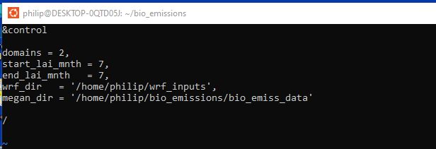
Bio_emissions
The biogenic emissions were followed largely in the same way as the Anthro_emiss ones.
Assuming you’ve got a bio_emissions dir (if not check out the youtube tutorials earlier)
These are monthly so not quite as intensive as Anthro
Open your “bioemiss_megan.inp”
Set the same wrfinputs dir as you did for Anthro
Set your megan data dir
Run with:
./megan_bio_emis < bioemiss_megan.inp

Slide 17
Chem_conv_tr and cu_diag
WRF Errors
Chem_conv_tr=1 requires cu_diag=1
Chem_conv_tr is subgrid convective transport (this is typically on/set to 1)
Cu_diag turns on time average cumulus clouds. Not entirely certain what this means
A domain without a parameterization won’t use either of these (set to 0)

Slide 18
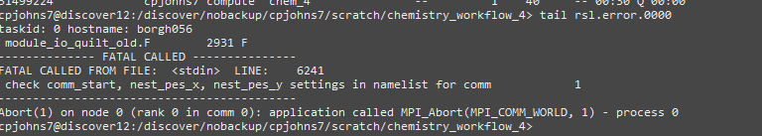
WRF Errors
Appears when I have nproc_x and nproc_y on in the &domain section and it doesn’t like the choices.
Easiest solution is to turn nproc_x and y off if you can

Slide 19
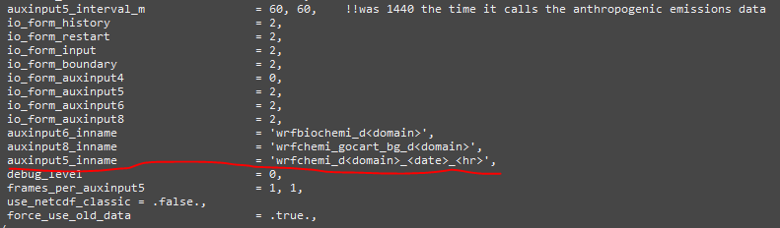
WRF Errors
“med_read_wrf_chem_emissions: error opening wrf_chemi_00z_d01”
I believe this is related to me not having the auxinput5_inname specified:

Slide 20
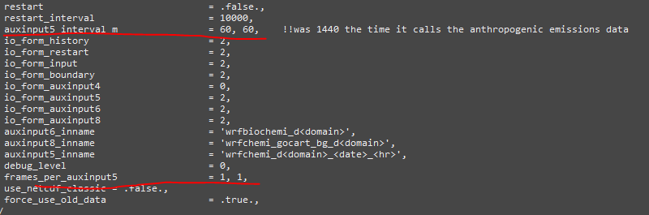
WRF Errors
You may need to make sure to specify the chemistry file names and setting the interval to an hour and thus each chemi file only having that hours data.

Slide 21
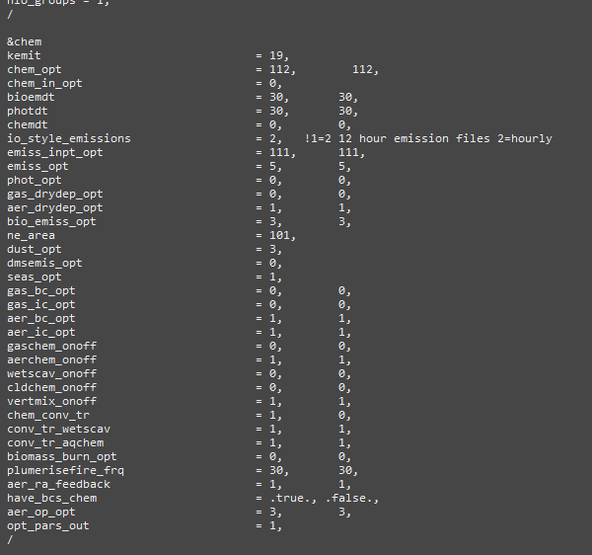
Chemistry settings
I’m running an aerosol-focused simulation and from the tutorial and all that I’ve stated in this guide these work for me.
It’s important to note that my sims are running direct and indirect radiative feedback effects which you can find more info on in the wrfchem user guide

Slide 22
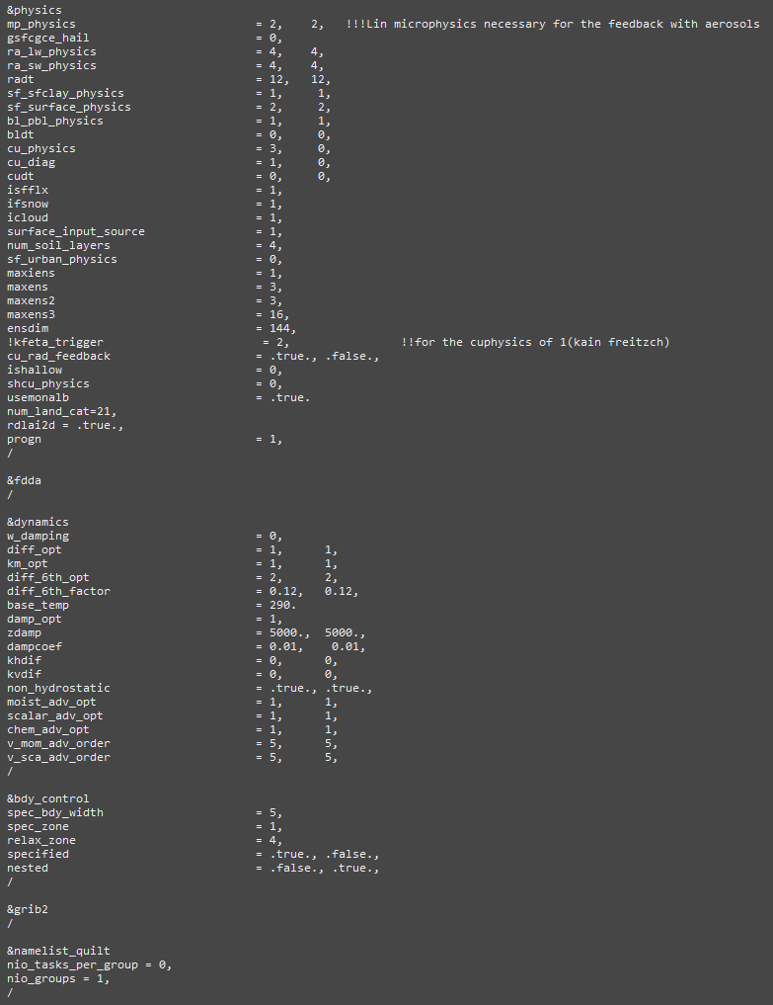
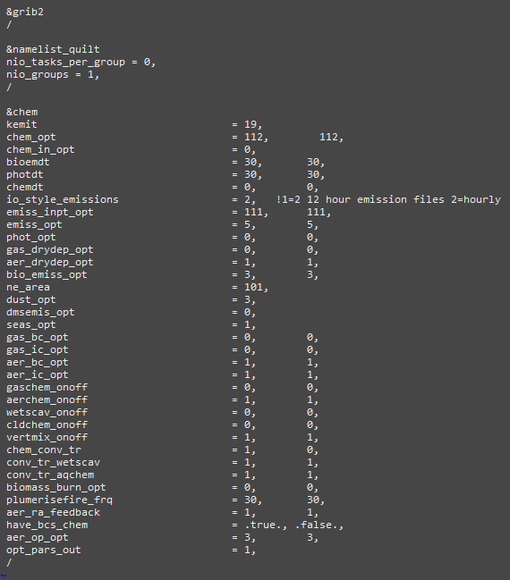
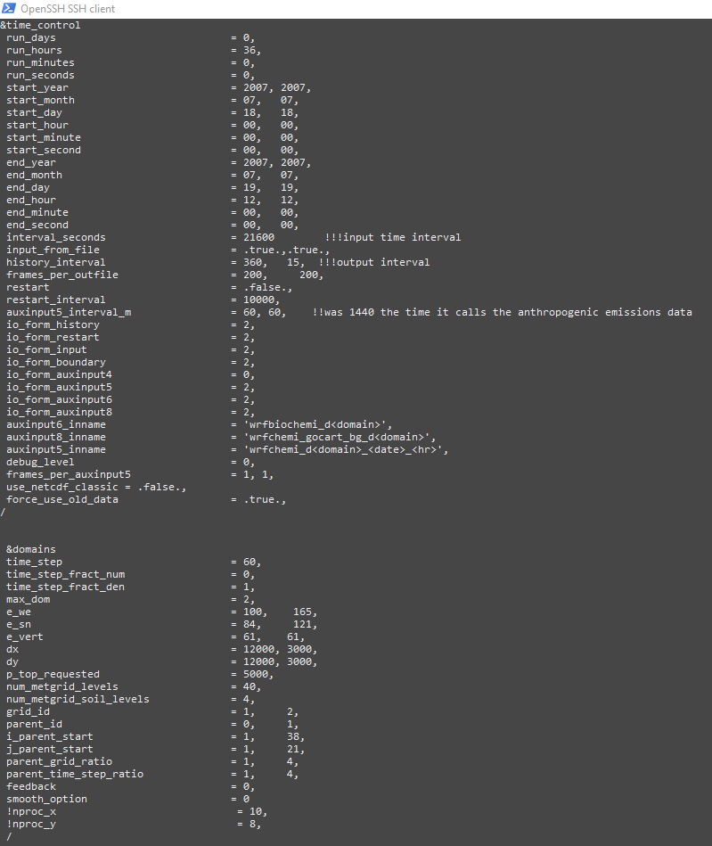
Chemistry Settings Full namelist

Slide 23
No Chemistry
If running with zero chemistry to compare against the chem, comment out the following
Auxinput5_interval_m
Cu_diag
Cu_rad_feedback
Progn
Chem_adv_opt
!io_form_auxinput5 = 2,
!io_form_auxinput6 = 2,
!io_form_auxinput8 = 2,
!auxinput6_inname = 'wrfbiochemi_d<domain>',
!auxinput8_inname = 'wrfchemi_gocart_bg_d<domain>',
!auxinput5_inname = 'wrfchemi_d<domain>_<date>_<hr>’,
!frames_per_auxinput5 = 1, 1,
The entire &Chem section

Slide 24
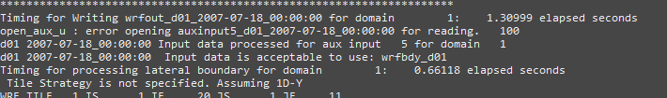
No Chemistry
Turned off chemistry but getting this error?
Comment out
tracer_adv_opt = 4, 4, chem_adv_opt = 2, 2 ,
Try reducing processors and rerun real with no chemistry settings. Delete them(chem settings) (after copying the original namelist of course)

